Slide 1

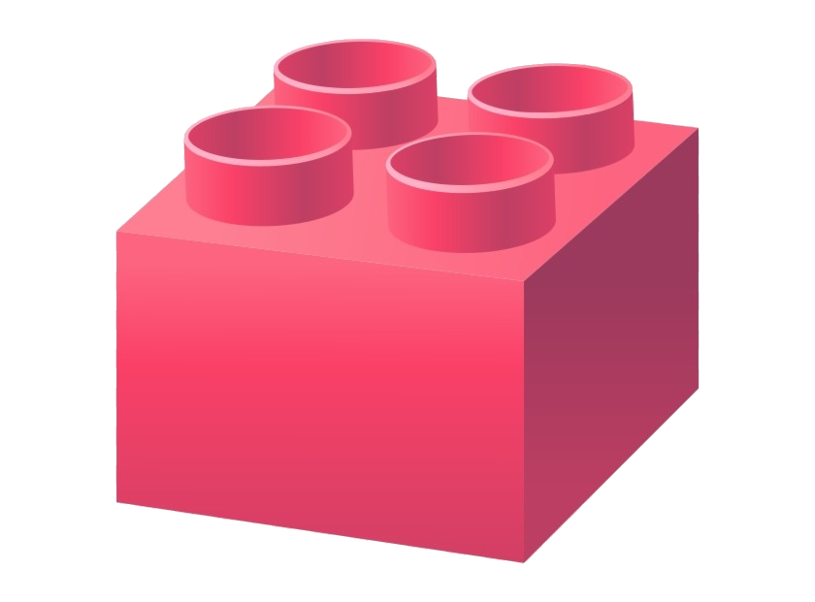
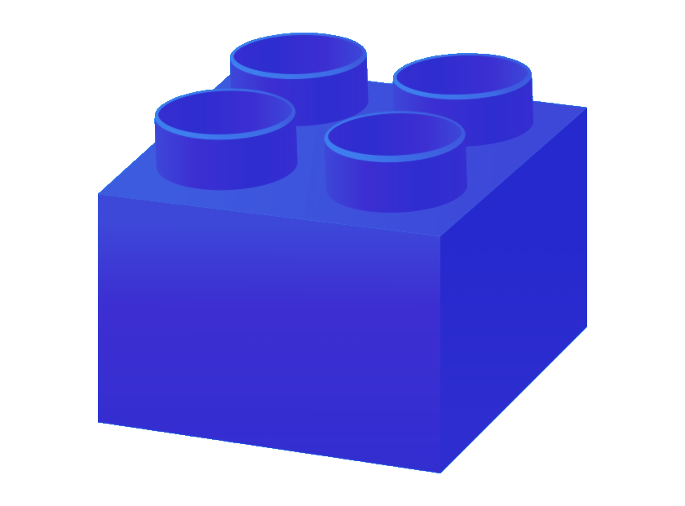

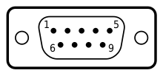

Embedded Communications 3/3
Embedded
Systems II
I2C
SPI
L11
Dr Simon Winberg
Electrical Engineering
University of Cape Town

Slide 2
ES Communications Training Plan
Comms 1:
Intro: Serial vs Parallal, Synch/Asynch
Comms 2:
I2C & SPI
UART
RS232 & RS485
PWMs & Peripherals (not used yet in Prac2)
Comms 3:
Timers
Brieﬂy, some other interface protocols
{Brief Introduction to Wireless Communications – if time permits}

Slide 3
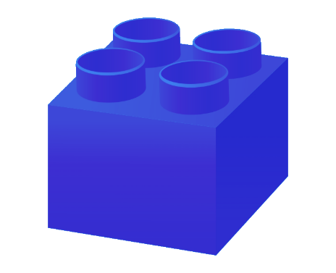
The SPI Protocol
SPI

Slide 4
SPI Overview
SPI = Serial Peripheral Interface
Communication protocol developed by Motorola (Freescale) in 1979
Full duplex (both ends can transmit simultaneously)
Serial (bits sent sequentially),
Synchronous (uses a shared clock)
Faster than I2C, but slightly more complex and requires more lines.
No Start/Stop commands, or addressing, instead a dedicated slave select line is used
Supports multiple slave devices on the same bus with a single master
Also used on PCBs and between nearby chips (only works over short distances). e.g. ADC, Temperature sensor, RTC, SD card, EEPROM

Slide 5
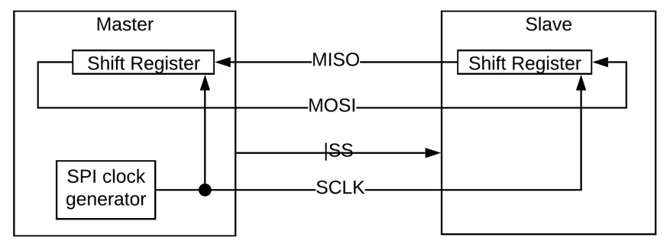
SPI Overview
SPI Interface Lines
Lines required:
SCLK: Clock generated by master
MOSI: Master Out Slave In
MISO: Master In Slave Out
!SS: Slave Select, active low (hence !) // SS sometimes called CS=Chip Select
Operation:
Master-generated CLK moves data onto the data transfer lines (MOSI, MISO) and from/into the end point shift registers simultaneously.
Can use | or ! to indicate active low

Slide 6
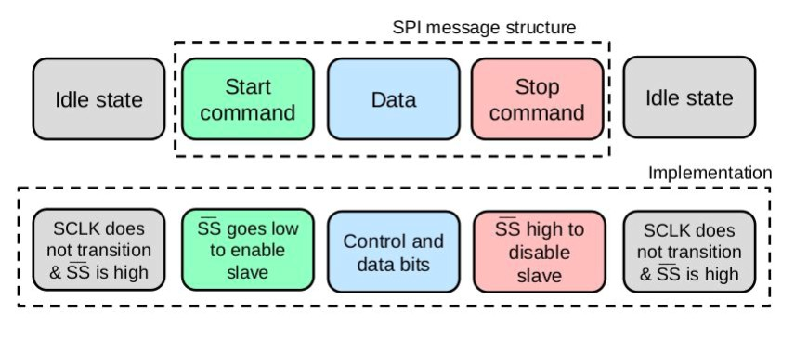
SPI Protocol
Top: state of operation Bottom: what happens on signal lines
Three pretty simple parts…
Idle state: SCLK not switching, !SS HIGH
!SS pulled LOW: Starts data transfer from the 1st clk edge (rising or falling depending on mode)
!SS going HIGH: Disables any slaves and stops data movement

Slide 7
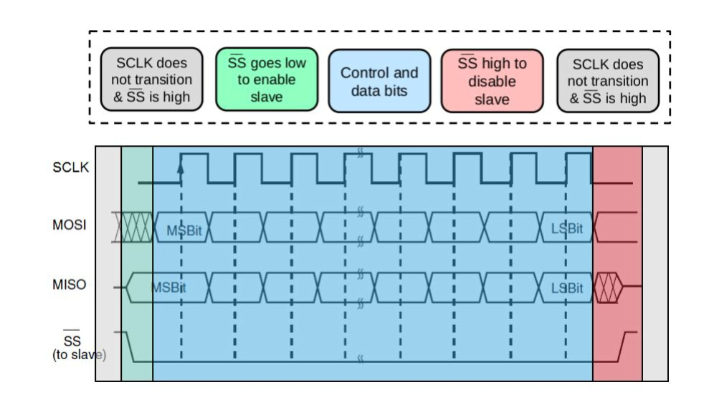
SPI Protocol
Top: state of operation Bottom: what happens on signal lines
Three pretty simple parts…
Idle state: SCLK not switching, !SS HIGH
!SS pulled LOW: Starts data transfer from the 1st clk edge (rising or falling depending on mode)
!SS going HIGH: Disables any slaves and stops data movement

Slide 8
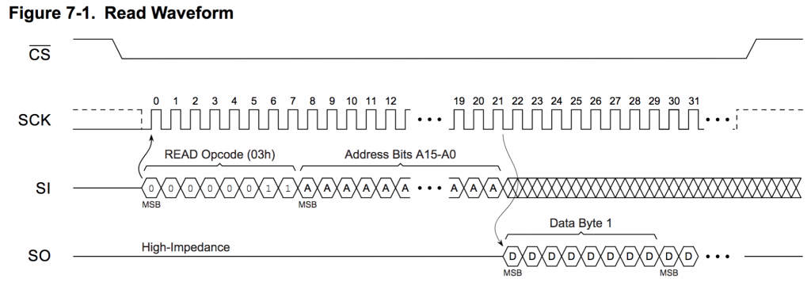
Example transmission in spi

Slide 9
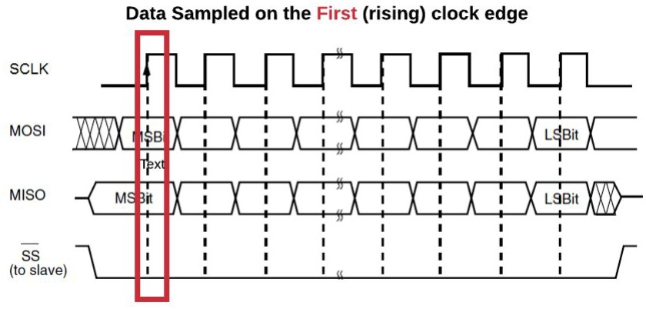
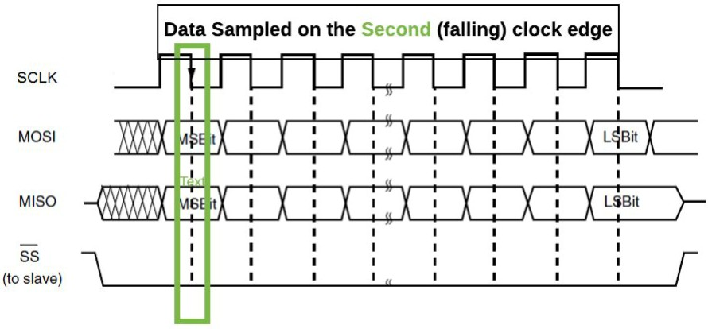
SPI Protocol – Clock Phase (CPHA) Settings
SPI Settings …
Rising clock edge → Data sampled on the first clock edge (rising)
Falling clock edge → Data sampled on the second clock edge (falling)

Slide 10
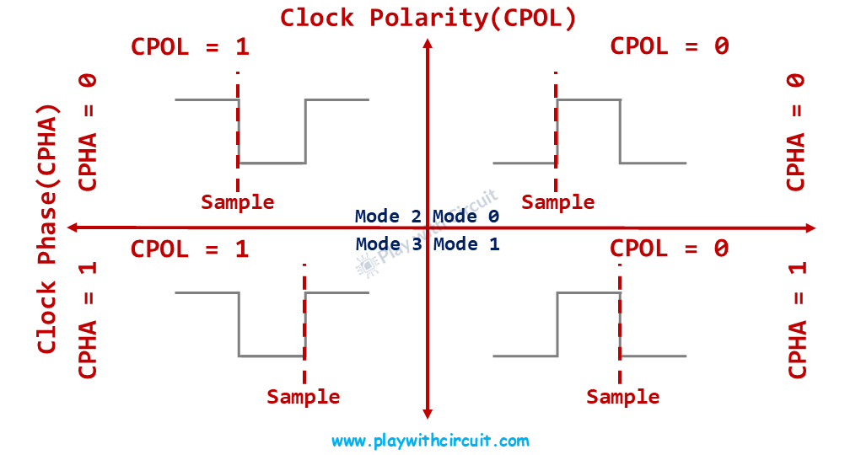
SPI Modes
CPHA – clock phase, this determines at which edge the data is sample = 1 (rising edge) = 0 (falling edge) CPOL – clock polarity, determines the idle state of a clock line. =0 (Low) =1 (High)
Falling edge – towards the default
Notes:
CPOL – clock polarity
If its 1, the clock pol flips, and rising edges become falling edges

Slide 11
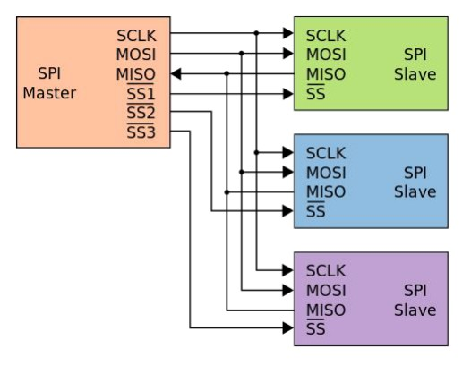
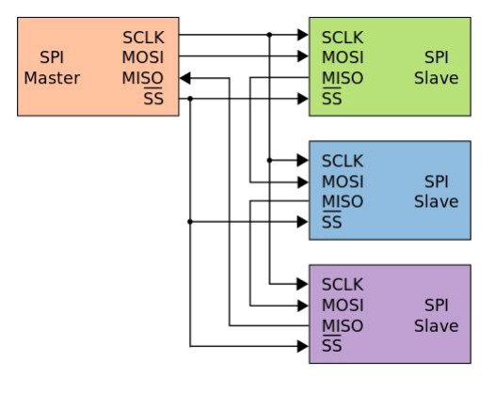
SPI: Multiple Slaves
Approaches to set up SPI connections for one Master with multiple slave devices.
A typical SPI bus configuration with dedicated slave select lines: e.g.
Master and three independent slaves.
In this configuration each new slaves requires an additional dedicated !SS line for individual control
Daisy-chained SPI bus: master and cooperative slaves. Each slave much forward on the MOSI input out its MISO output on the next SCLK.
(can allow for more devices connected up with shorter cables, but catch is higher latency)
Might appear in a test!

Slide 12
SPI in context
Key Disadvantage:
Only 1 master possible
If independent access to many slaves is required the number of !SS lines quickly grows
Key Advantages:
No overhead of addressing and start/stop/ACK
Full duplex

Slide 13
UART
Universal Asynchronous Receiver Transmitter
&
RS232 Protocol Standard

Slide 14
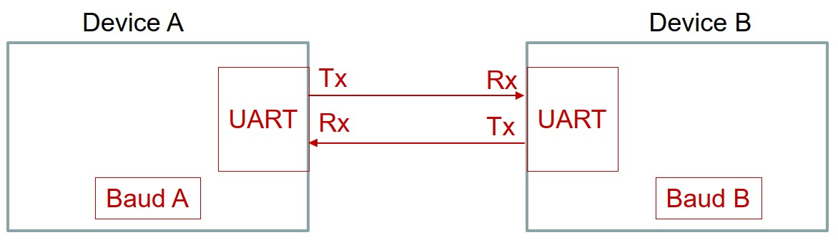
What is meant by UART?
The Universal Asynchronous Receiver Transmitter (UART) refers to the generic hardware interface Tx/Rx control module, not to a protocol! A UART could be an underlying driver that implements a protocol.
It is simply this type of setup …

Slide 15
UART & RS232
RS-232 is an asynchronous serial communication interface standard
This standard was introduced in 1960 for serial communication transmission of data.
It formally defines signals connecting between a DTE (data terminal equipment) e.g. computer, and a DCE (data circuit-terminating equipment), e.g. modem.
Has 25 and 9 pin connector options (25 pin ver. seldom used, few benefits over 9 pin)
Reference source & further info: https://en.wikipedia.org/wiki/RS-232

Slide 16

UART & RS232
How does UART and RS232 relate?!
Nowadays the approach is to control the RS232 lines via a UART module, commonly built in to a microcontroller or an onboard component. … and
Adding essentially some voltage conditioning circuitry.
RS232 voltage levels: -3V to -15V = logic 1 and +3V to + 15V = logic 0
Use a MAX232 to convert:
0 V to +12V and 3.3 V to -12V
0..3V
-12.. 12V
CONDIT-IONER
conditioner
conditioner
Condition voltage levels and if need boost current
Notes:
The MAX232 is an integrated circuit by Maxim Integrated Products, now a subsidiary of Analog Devices, that converts signals from a TIA-232 (RS-232) serial port to signals suitable for use in TTL-compatible digital logic circuits.

Slide 17
RS232 Standard Configuration
Speeds of.
1.2kbps, 2.4kbps, 4.8kbps, 9.6kbps, 14.4kbps, 19.2kbps, 115.2kbps *
RS232 was originally intended more for bit rates lower than 20kbps, but was kept going and still useable way beyond that.
The max RS232 speed is around 1Mbps
* here k = 1000
Max limit for UART? No explicit limit, left to developer to decide.

Slide 18
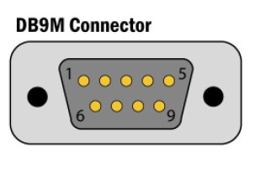
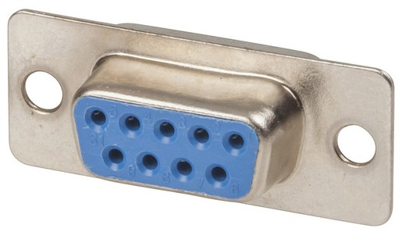
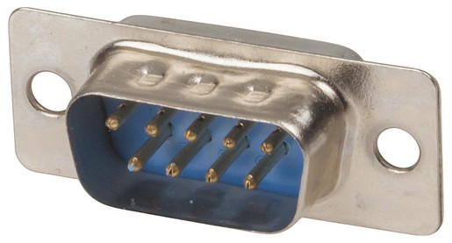
UART and the RS-232
DB9 connector coupling
Pin# | Signal
1 | DCD
2 | RX
3 | TX
4 | DTR
5 | GND
6 | DSR
7 | RTS
8 | CTS
9 | RI
Pinouts
DB9-F female connector
DB9-M male connector

Slide 19
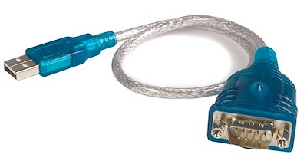
USB to RS232 Adapter
USB is a (seriously) complicated protocol, although very useful and well planned.
Here’s how to avoid hassles of having to figure out how to choose a use a standard USB protocol …
Just give your PC a RS232 port via connecting a converter via USB… easier approach.
Of course the downside to this is that your comms rate is going to be limited (don’t expect much, if even all that close, to 1Mbps)

Slide 20
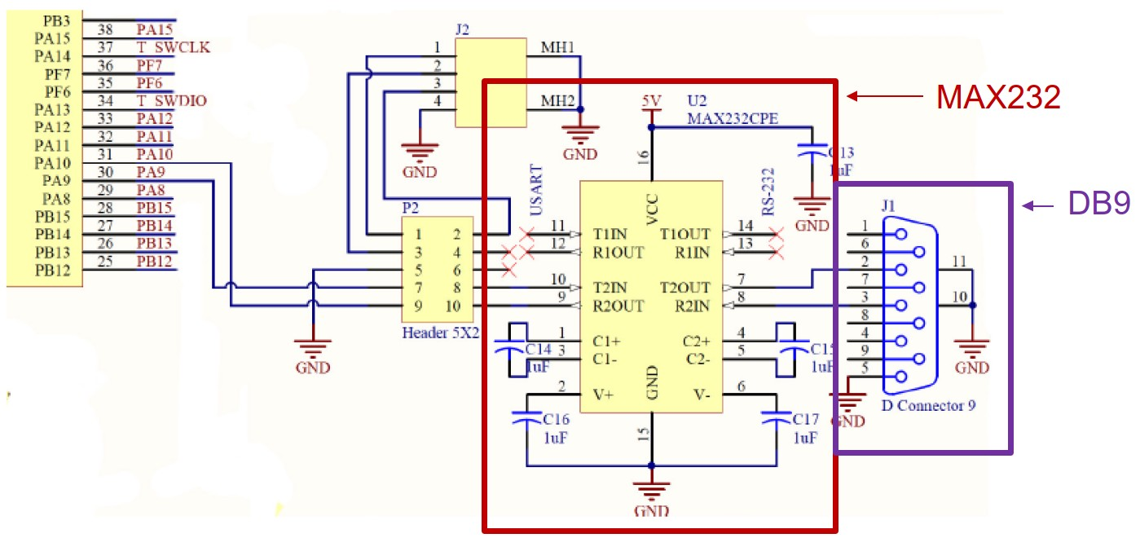
RS232 on STM32 UART → MAX232 → DM9
Illustration of connections needed to provide a RS232 port on the STM32F0:
Portion of schematic for STM32F0 development board. Source: Embedded Systems I course notes

Slide 21
RS-485
What is RS-485?
It’s kind of an enhanced version of RS-232
It’s also an electrical interface
Also usually uses UART hardware interface to drive the data exchange
RS-485 was developed to overcome the limitations of RS-232

Slide 22
RS-232 Limitations
Supports only one transmitter and one receiver on a communication bus (you might have noticed that after our I2C and daisy-chained SPI cases)
Allows data transfer for distances less than 15m. Signal lines (tx and rx) are referenced w.r.t ground and performance degrades quickly when there is noise present.
Allows rather limited speed of data transfer (especially for lengths beyond about a ~1m)

Slide 23
RS-485 differences to RS-232
How is RS-485 different to RS-232?
1. RS-485 uses a tri-state differential line driver to provide one of the following three states:
Logic low: ±1.5 V to ±6 V
Logic high ±1.5V to ±6V
High impedance: Not connected to bus
Big advantage of this adjustment:
This allows multiple devices to be connected to the same bus. When a
device is not transmitting, the transmit line is put to ‘High impedance’.

Slide 24
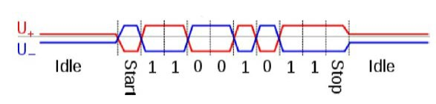
RS-485 differences to RS-232
How is RS-485 different to RS-232?
2. RS-485 uses differential signaling on two lines rather than a single-ended with voltage referenced to ground.
‘Differential signaling’ means that two lines are used, where one line has the negative voltage or the complementary signal of the other line. The receiver amplifies the difference between the two signals.
This makes RS-485 more noise immune than RS-232
Voltages on the U+ and the U- signal lines during transmission of one byte ( 0xD3 or b11001011)

Slide 25
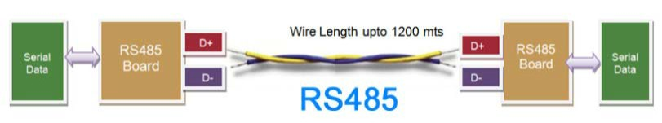
RS-485 differences to RS-232
How is RS-485 different to RS-232?
3. Recommended to use a twisted pair cable to transmit RS-485 signals. A twisted pair minimizes the gap between the two wires, which minimizes noise picked up by both the wires and immunity against interference.
Components of a half duplex RS-485 network, where a twisted pair cable is recommended to improve noise immunity

Slide 26
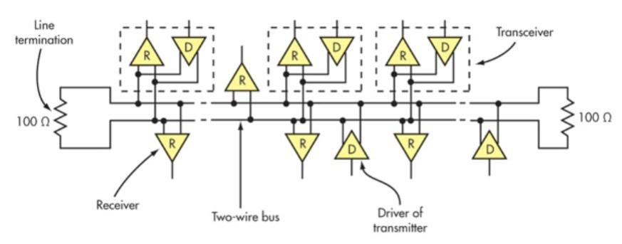
RS-485 differences to RS-232
How is RS-485 different to RS-232?
4. Supports up to 32 transmitters and 32 receivers on one communication bus
All receivers are fully connected to the communication bus
Line drivers are disconnected or put in a ‘high impedance’ state when they are not transmitting
The communication bus line is terminated in a load matching resistance, to minimise signal reflections from the end of the line s:
A RS-485 network showing many receivers(R) and transmitters / drivers (D) connected to the same communication bus

Slide 27
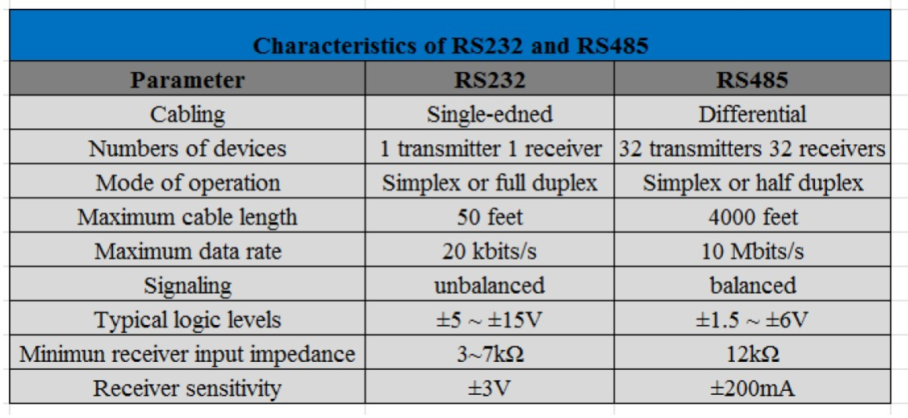
RS-485 versus RS232 Summary
Notes:
RS-232 is an unbalanced protocol, meaning it uses a single conductor for each signal and a common ground reference, making signals susceptible to noise and limiting effective communication distance to around 15 meters
RS-485 is a serial communication standard that uses a balanced, differential transmission method over a twisted-pair cable to achieve long-distance, noise-resistant data transfer

Slide 28
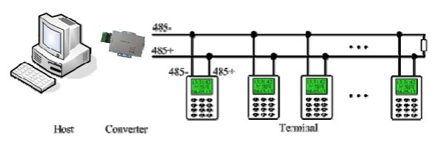
RS-485 Applications
Where is RS-485 used?
Commercial aircraft cabins
Building automation
Connecting electrical meters
Industrial control systems
Security electronics
Example of multiple devices connected to the same RS-485 network. A RS-485 to RS232 convertor may be used to interface to a host

Slide 29
Selection of References
[1] Understanding the I2C Bus (Texas Instruments application note) https://www.ti.com/lit/an/slva704/slva704.pdf
[2] Serial Peripheral Interface (wikipedia) https://en.wikipedia.org/wiki/Serial_Peripheral_Interface
Suggested further reading/understanding:
STM32F0 MINI TUTORIAL – USING THE I2C (in C)
MikroC SPI Library (shows some STM code examples but these are more direct H/W register access, gives a view of what happens within the STM32CubeIDE HAL layer)

Slide 30
Suggested Reading*
Resolving I2C Address Conﬂicts
https://embeddedartistry.com/blog/2021/08/02/resolving-i2c-address-conflicts/
(this is to consolidate I2C understanding and also awareness of the advantage and also drawback of I2C addressing aspect).
* This is of course more I2C and Prac2 related, although taking those principles further from what we would likely use in this course or the project.

